Slide 1
usegalaxy.no and connection to NeLS
Given by Jon K. Lærdahl (jonkl@ifi.uio.no)
ELIXIR Norway, Norwegian e-infrastructure for Life Sciences and usegalaxy.no

Slide 2
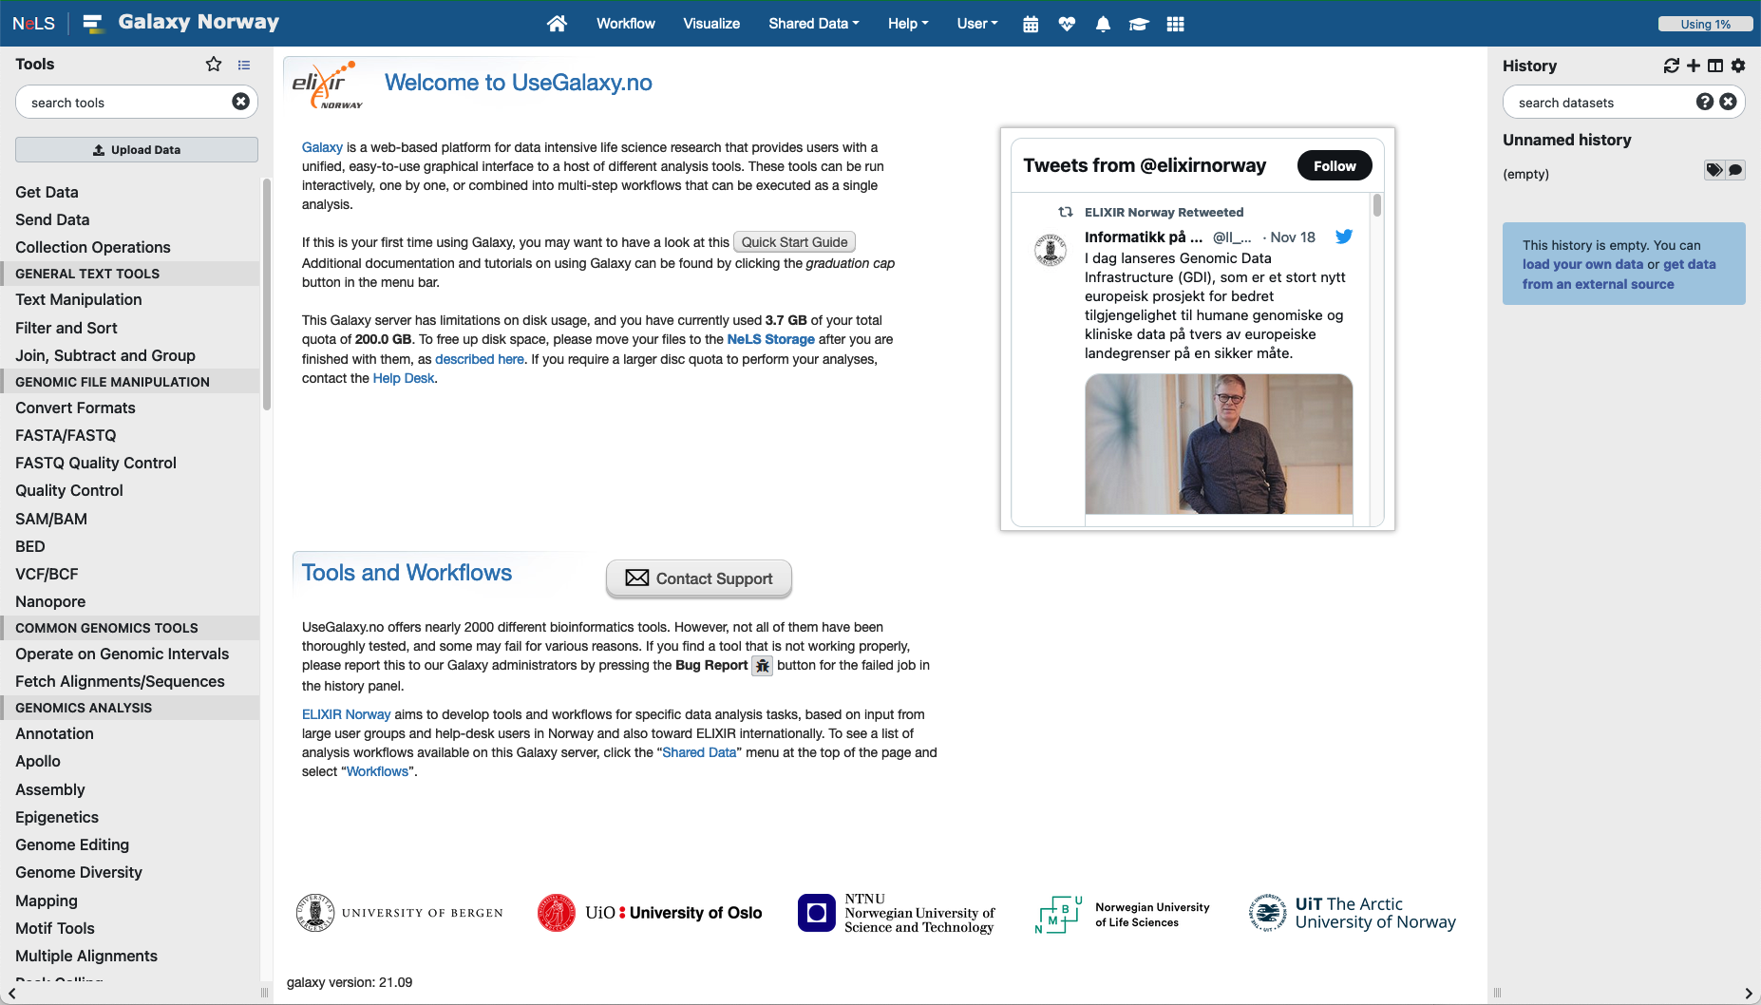
usegalaxy.no – The national Galaxy server
Web-based platform
Provide bioinformatic tools and workflows
Open to all Norwegian users and collaborators
Enable accessible, reproducible, and transparent computational biomedical research
Directly connected to the NeLS storage

Slide 3
usegalaxy.no – The basics
Main menu
Important features:
Tools menu with ~2000 tools sorted in sections
Current disk usage (default is 200 GB total personal disk space)
Status of compute backend
Quick start guide
Contact support
Help and guides
History
Main window
Tools menu

Slide 4
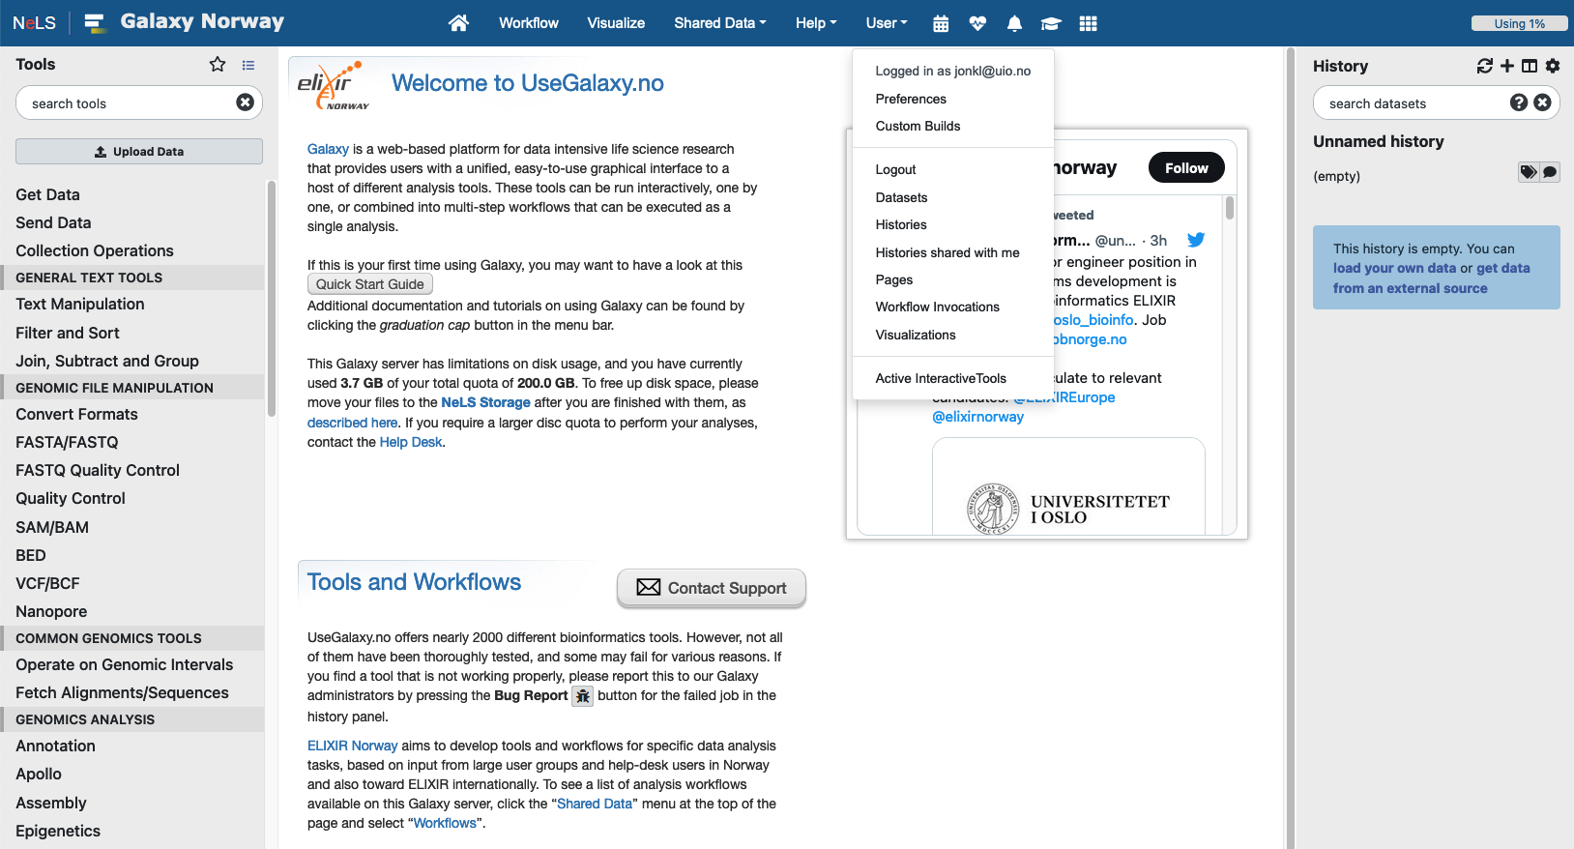
Your account and saved data
“Home”
Account settings and saved data such as saved histories and visualizations
Histories other users have shared with you
Log of analysis workflows you have run

Slide 5
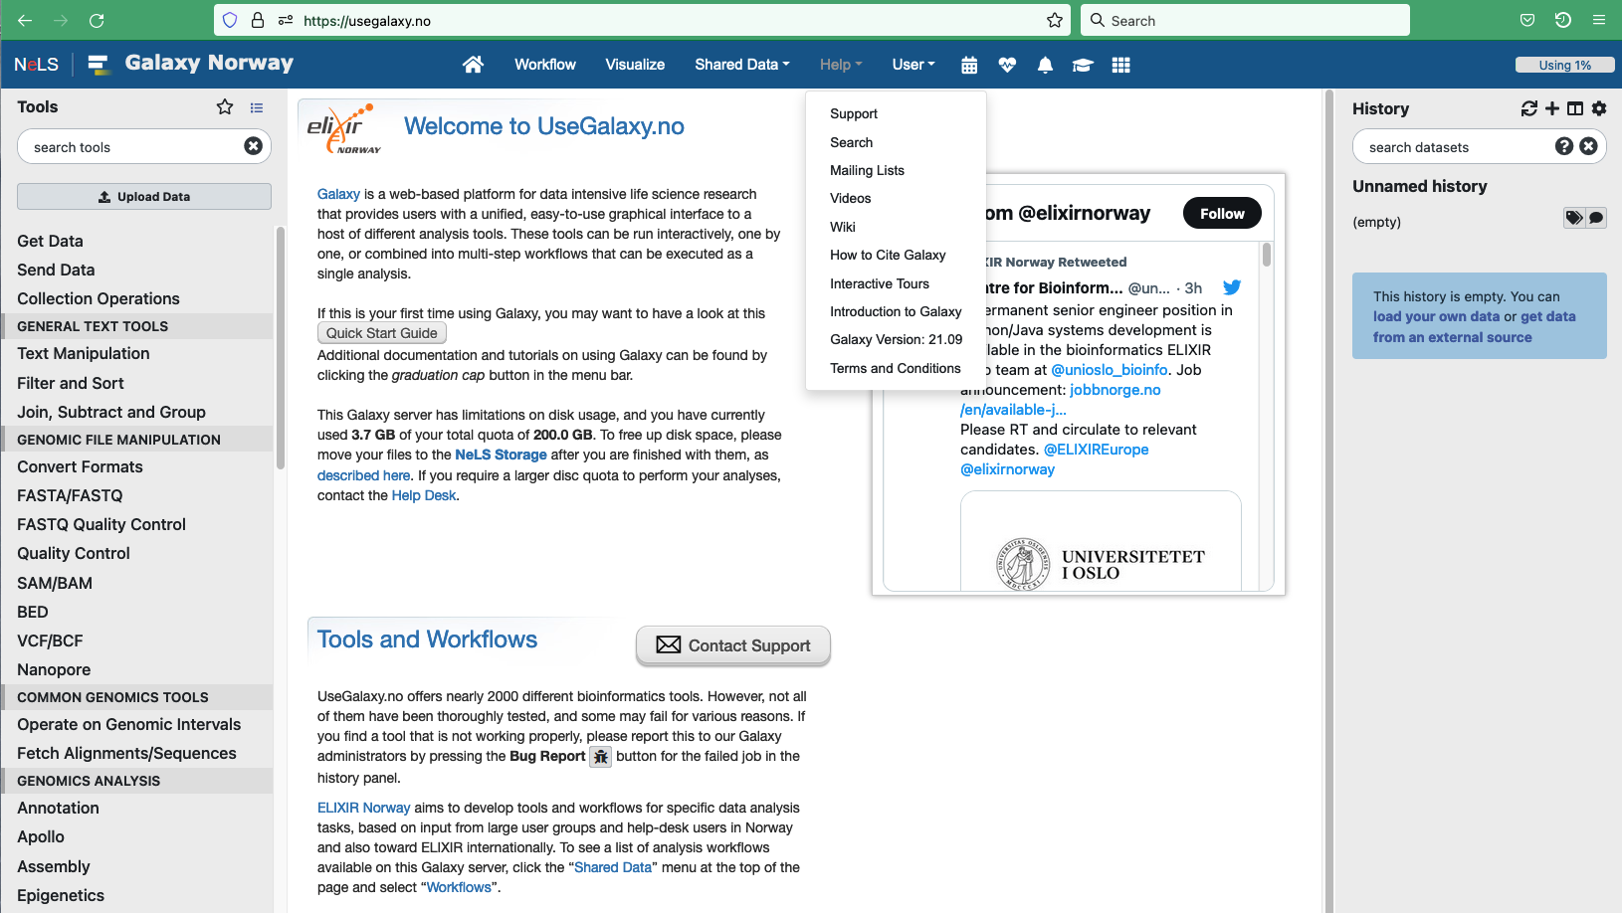
Recent updates
Support and tutorials
Contact ELIXIR Norway helpdesk for support
Access to Galaxy wiki, and Galaxy Project tutorials/videos
Interactive Galaxy “tour”

Slide 6
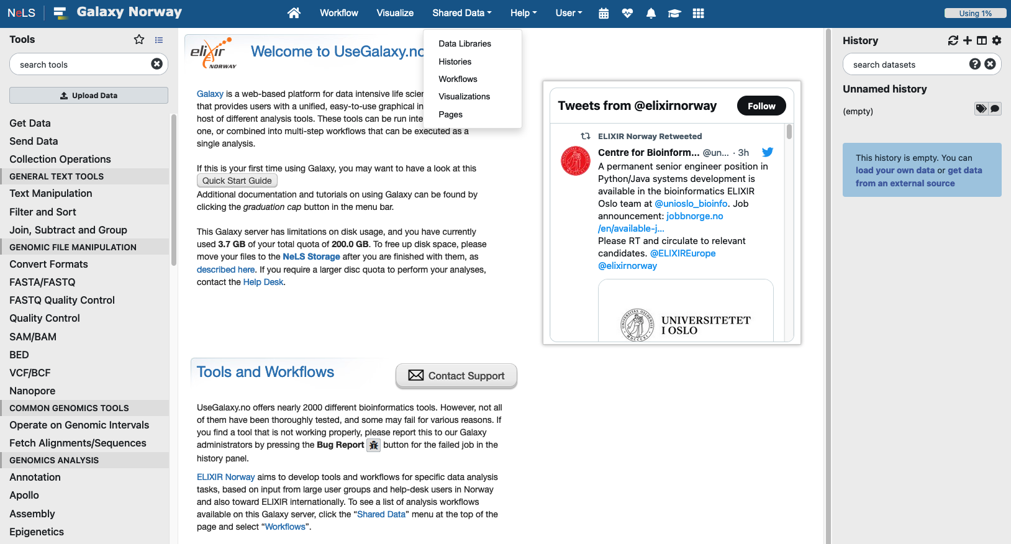
Links to Galaxy Project training
Shared data
Data shared by other users or ELIXIR-NO with all users of usegalaxy.no
For example, workflows and complete histories
You can import shared data to you user

Slide 7
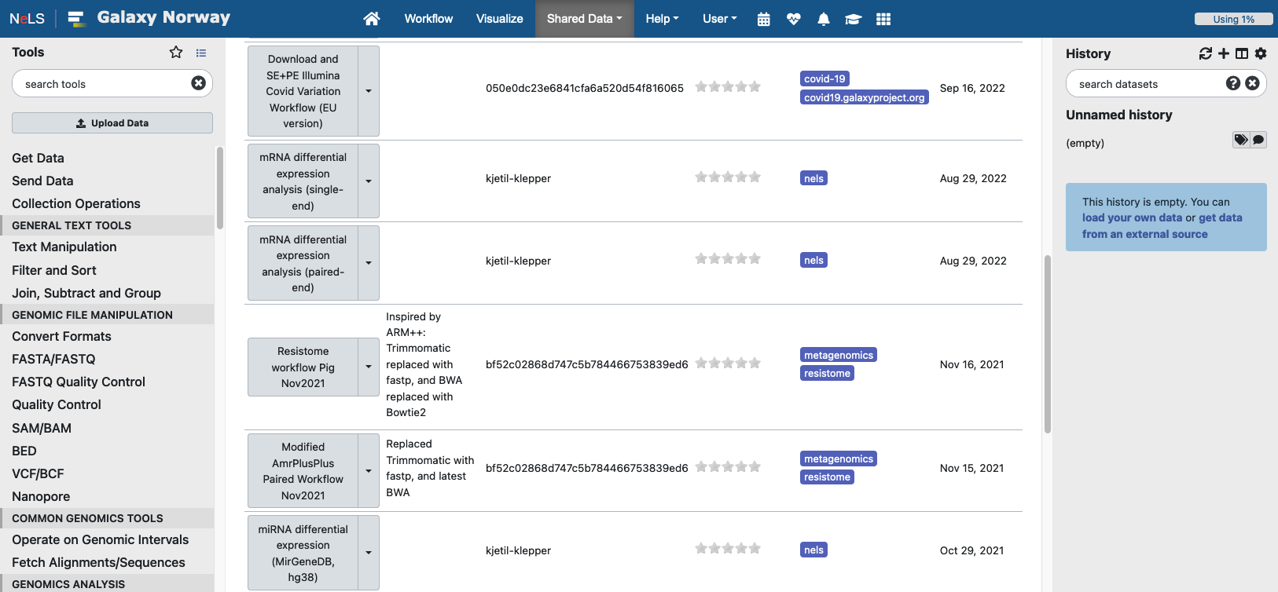
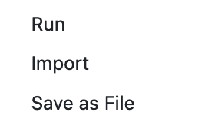
Shared data: workflows
List of all workflows that are shared with all usegalaxy.no users
You can import shared data to your own user
By selecting any workflow you can run data analysis, import into your user or save it on another computer

Slide 8
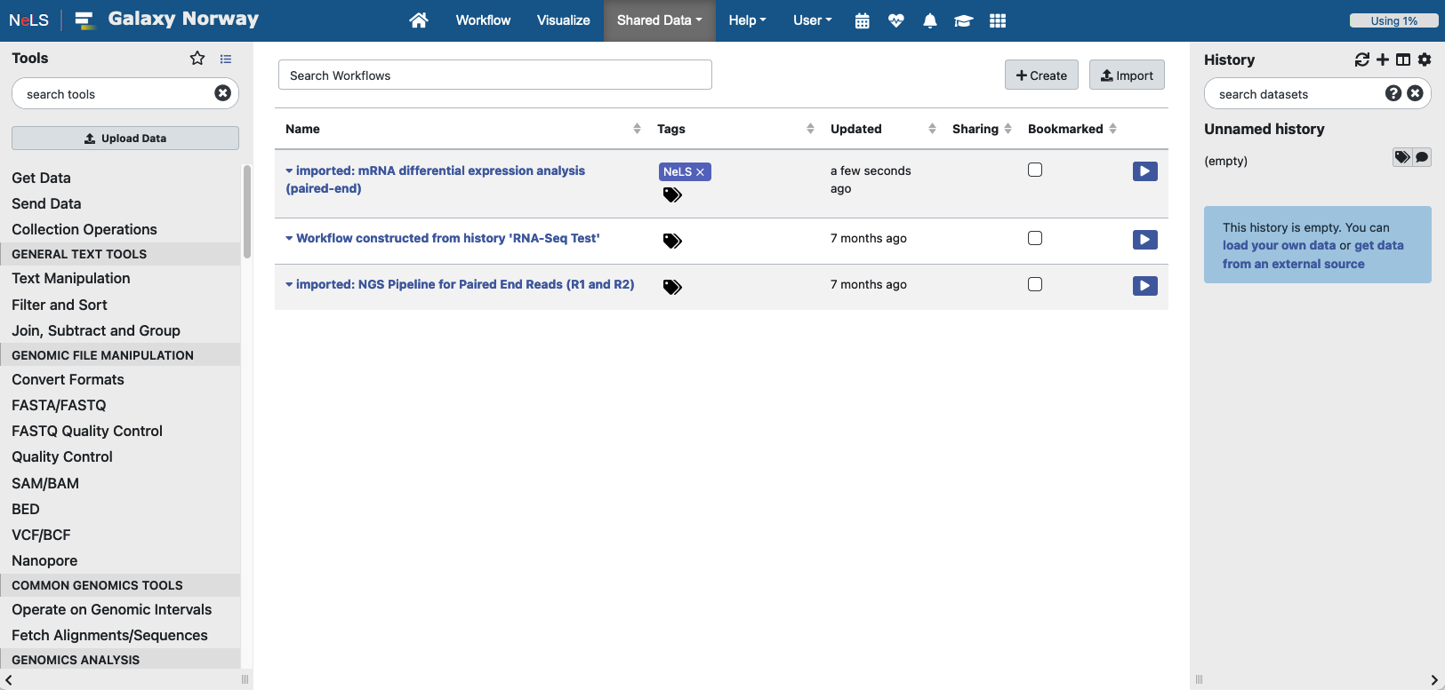
Workflows
Your own workflows. These are the imported or the workflows you have made yourself
You can create new workflows here

Slide 9
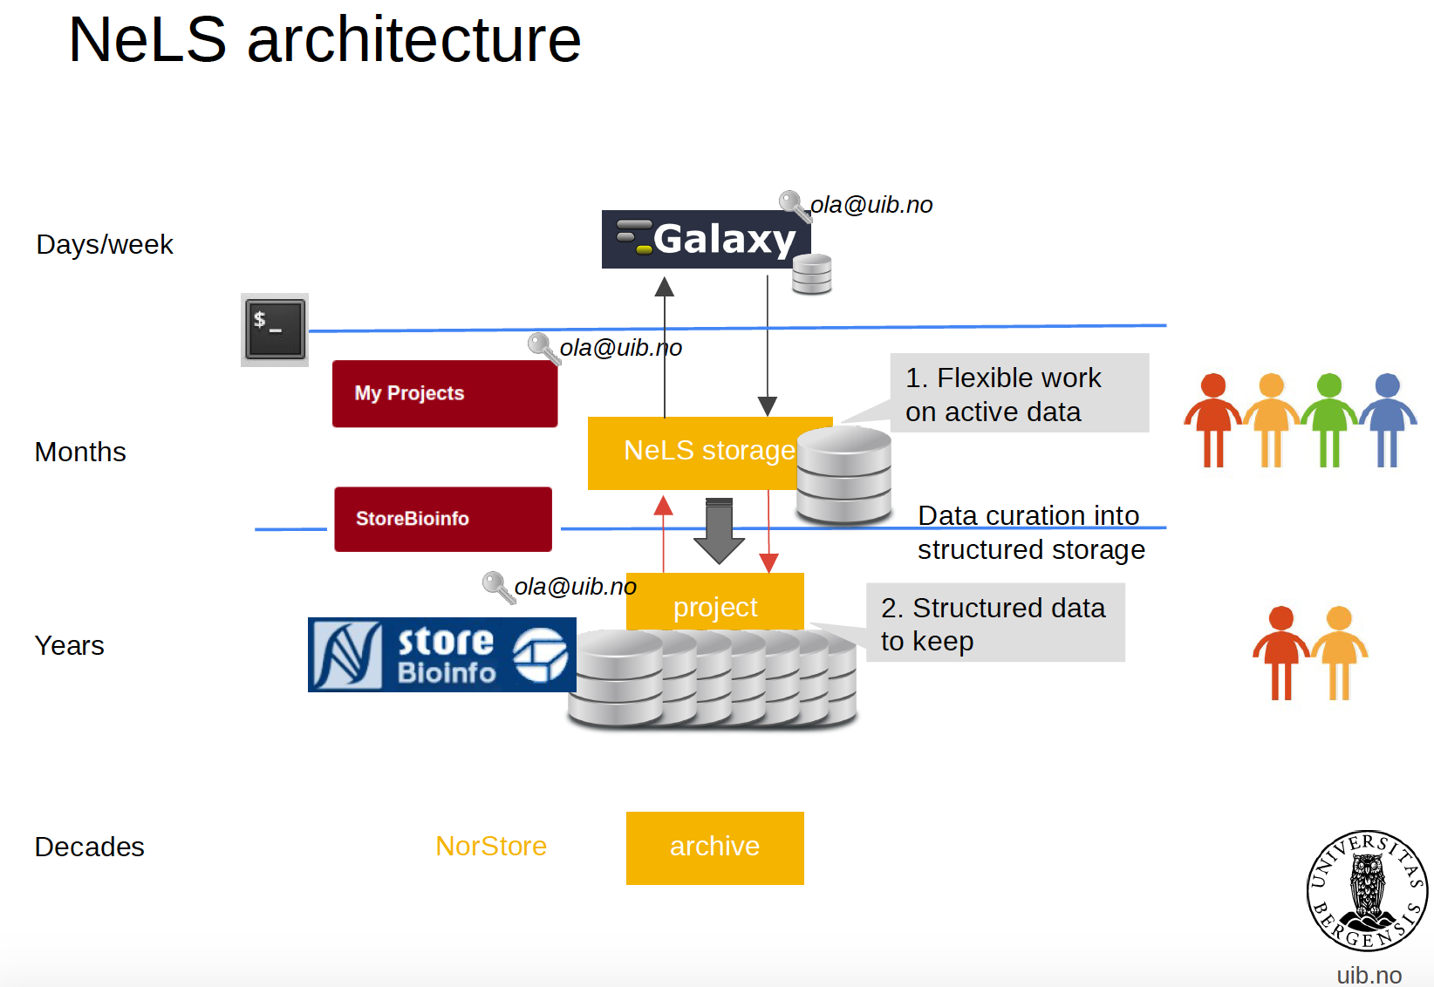





Usegalaxy.no is connected to NeLS
Data can be transferred directly
Research data archive

Slide 10
Importing data from your computer
Drag and drop, or browse and select file
Alternatively, paste URL for data available on the web
Specify datatype if you know (e.g. Fasta)

Slide 11
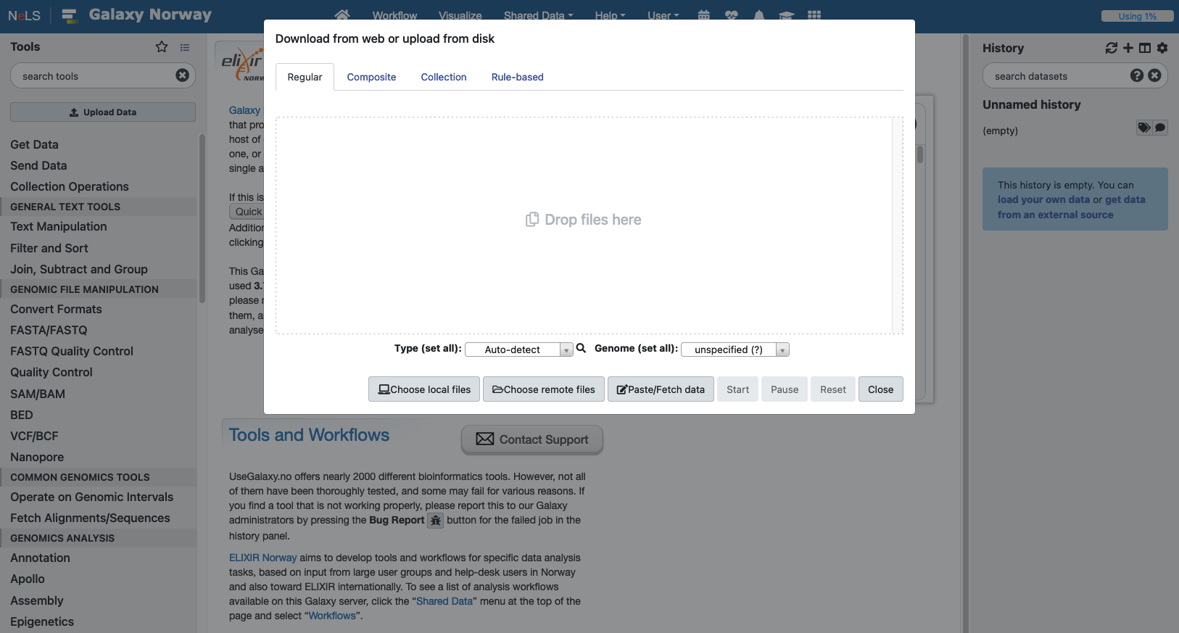
Importing data from your computer
Drag and drop, or browse and select file
Alternatively, paste url for data available on the web
Specify datatype if you know (e.g. fasta)

Slide 12
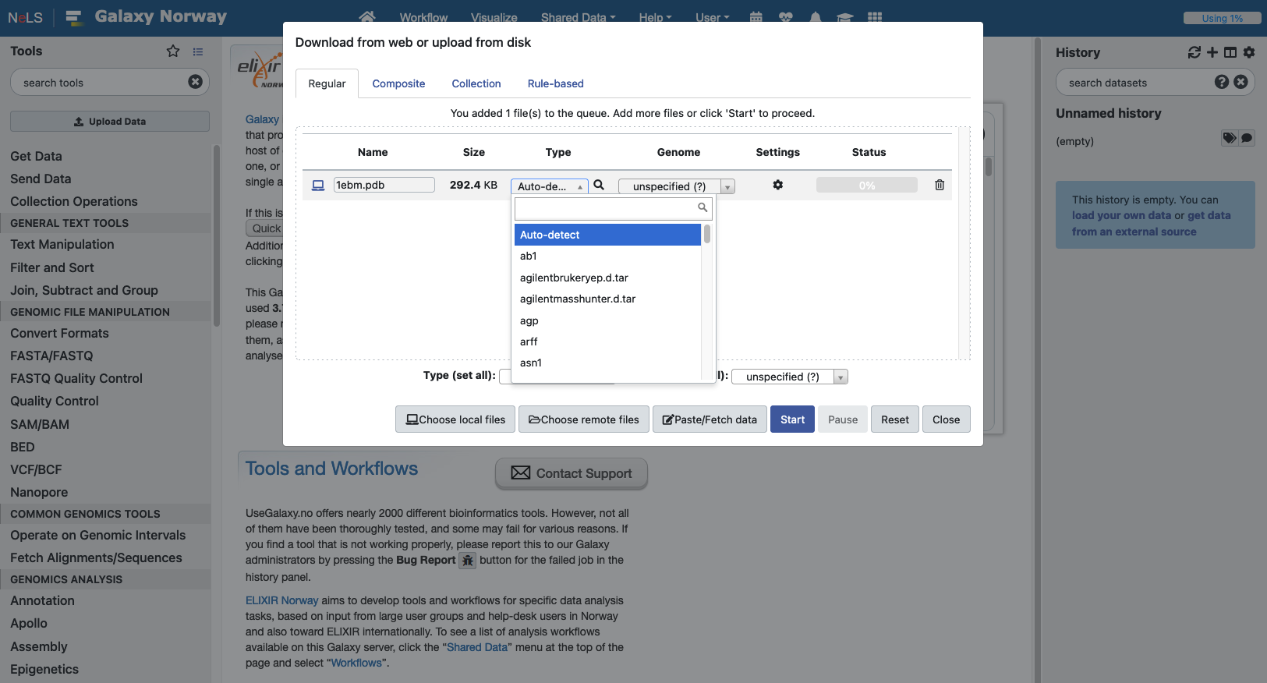
Importing data from your computer
Drag and drop, or browse and select file
Alternatively, paste url for data available on the web
Specify datatype if you know (e.g. fasta)

Slide 13
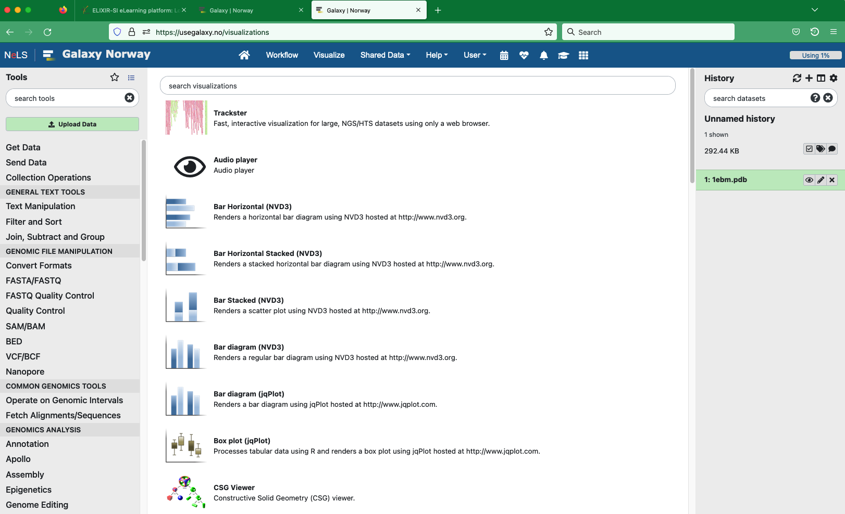
Visualize
Various tools for visualizing data in your history

Slide 14
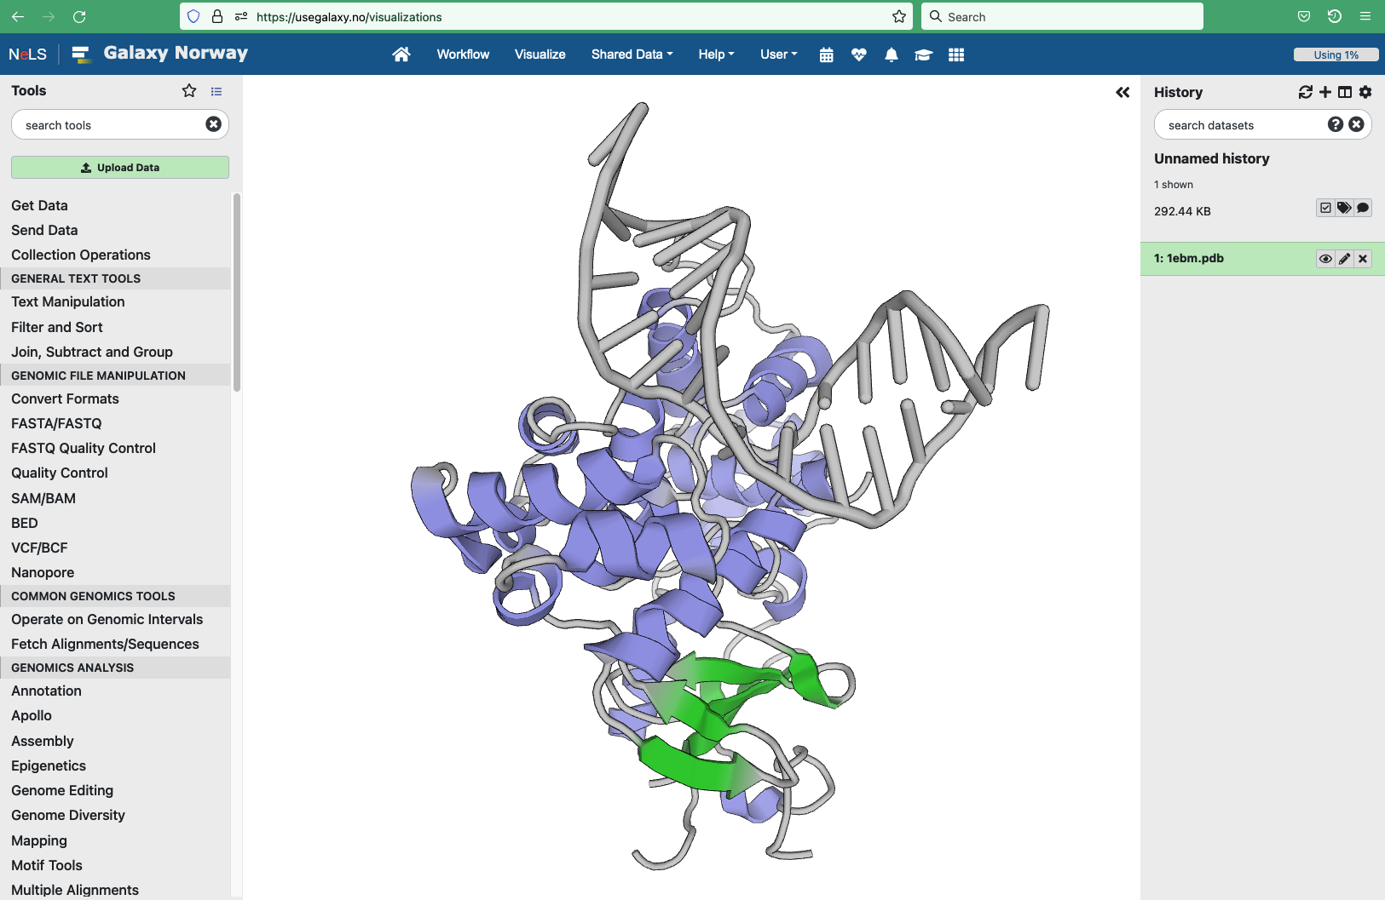
Visualize
Various tools for visualizing data in your history

Slide 15
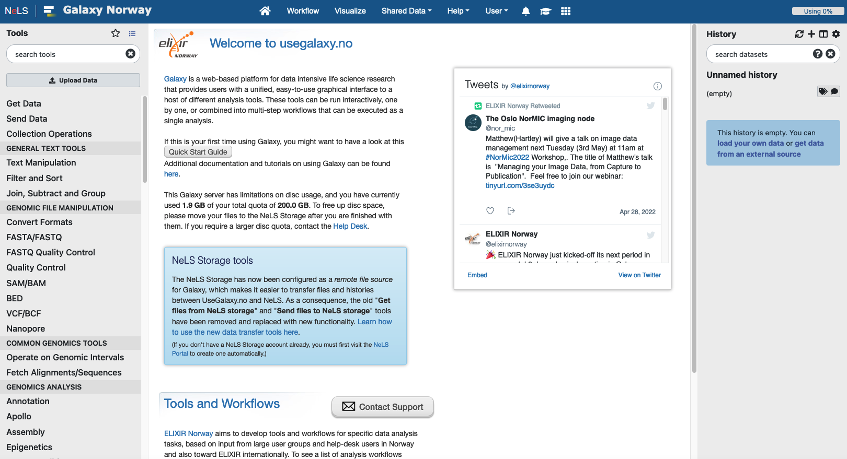
Importing data from NeLS
Import data from Personal or Project folders in NeLS

Slide 16
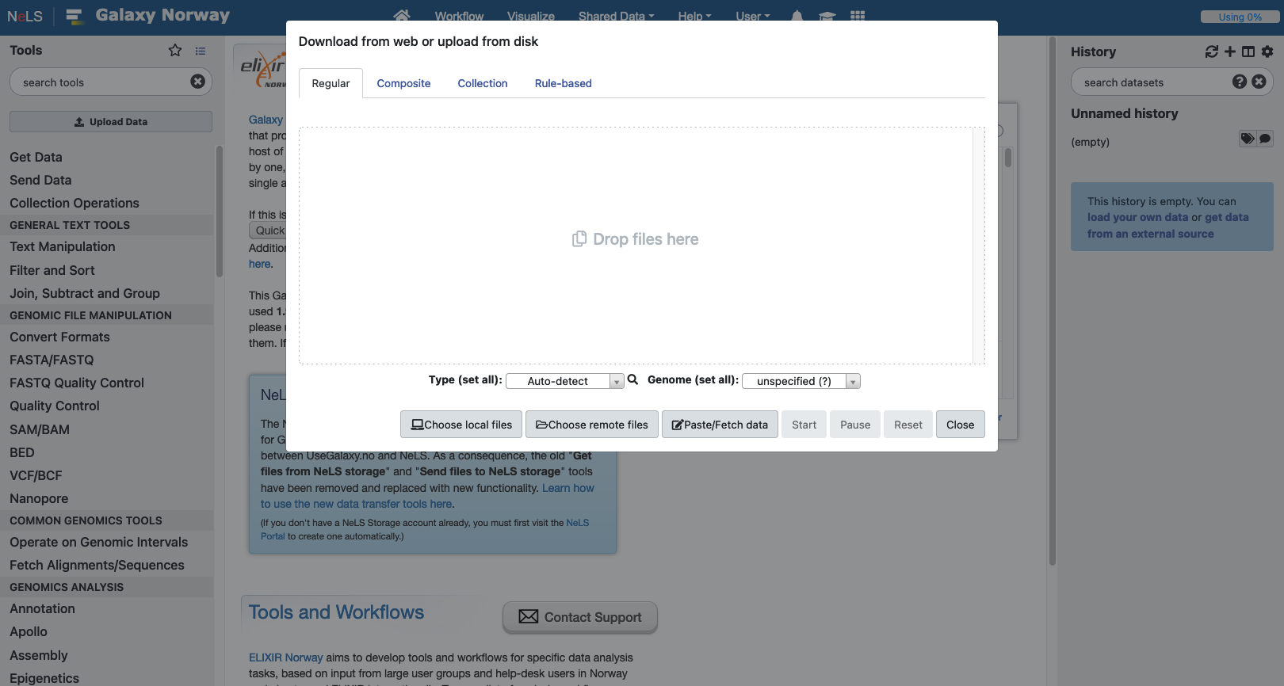
Importing data from NeLS

Slide 17
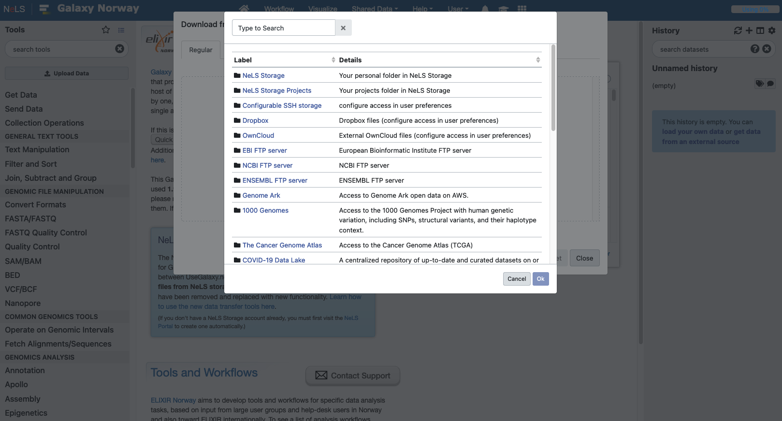
Importing data from NeLS

Slide 18
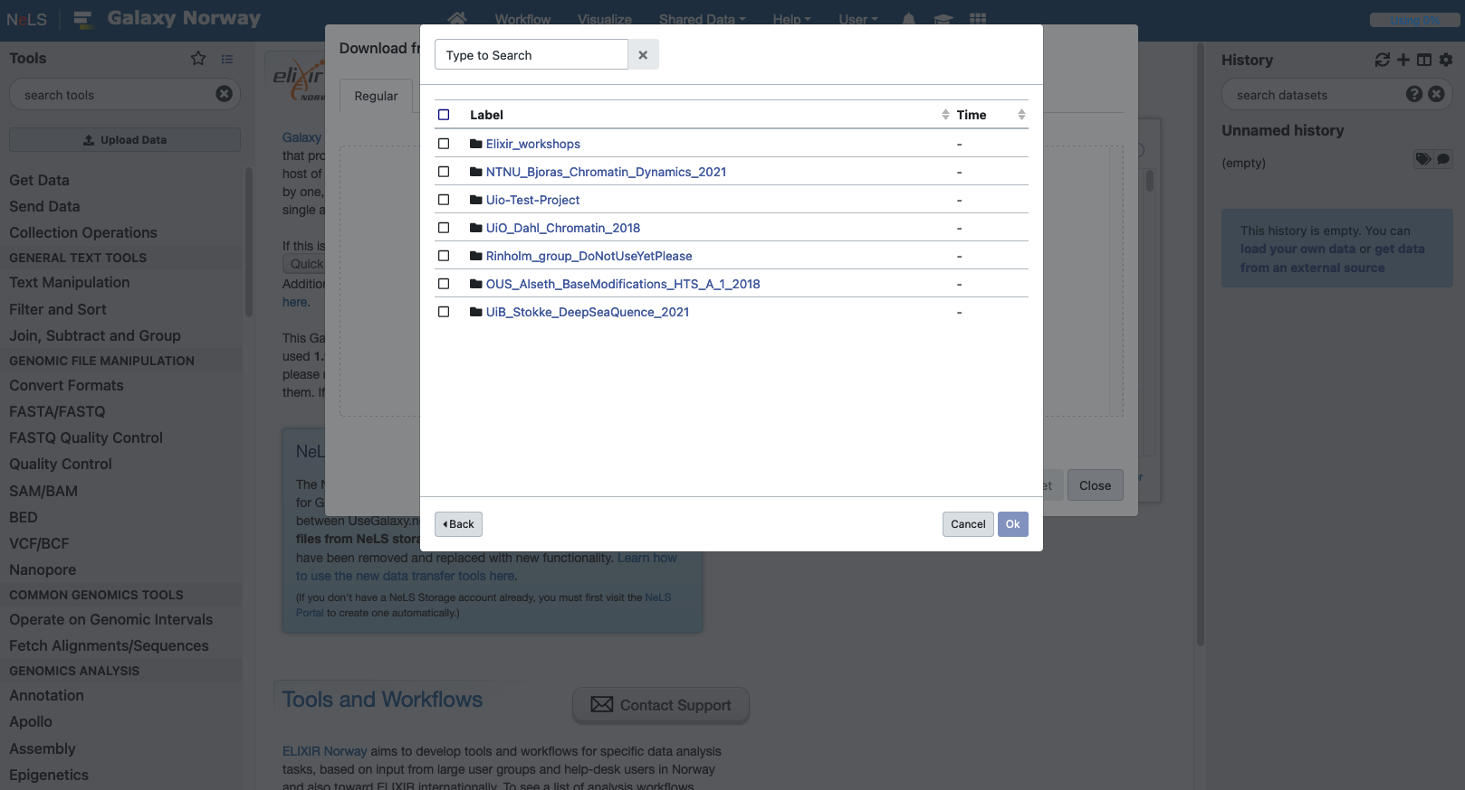
Importing data from NeLS

Slide 19
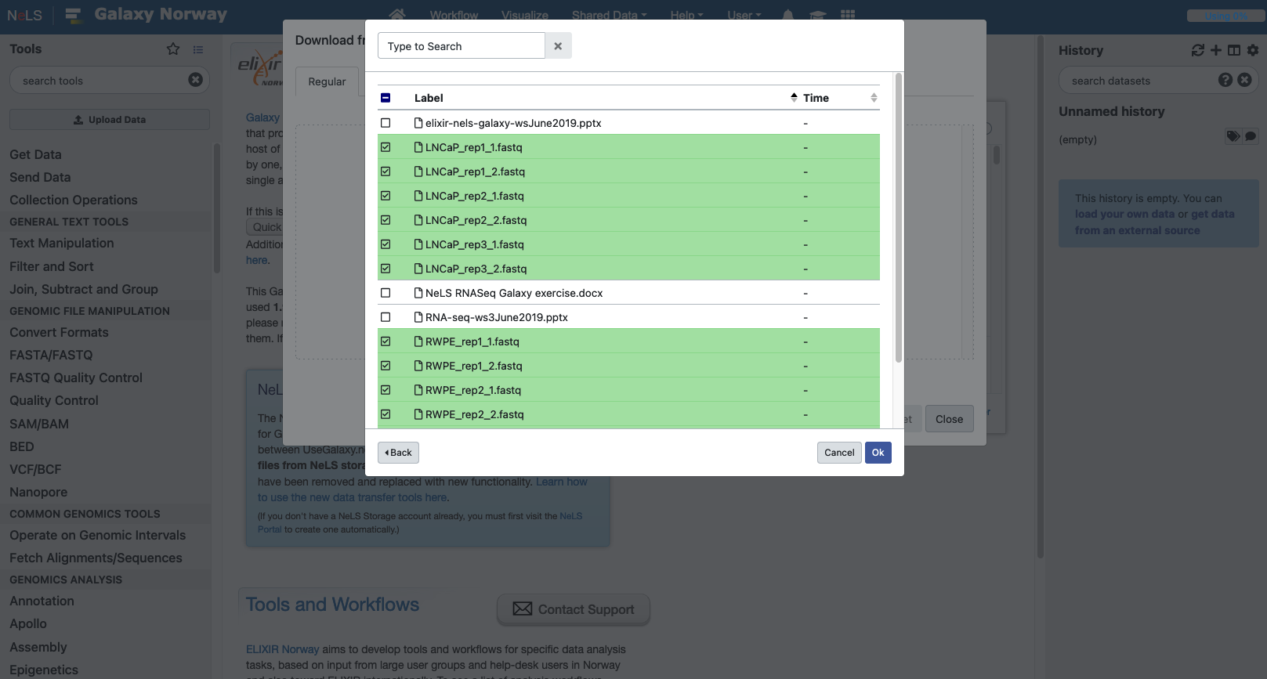
Importing data from NeLS

Slide 20
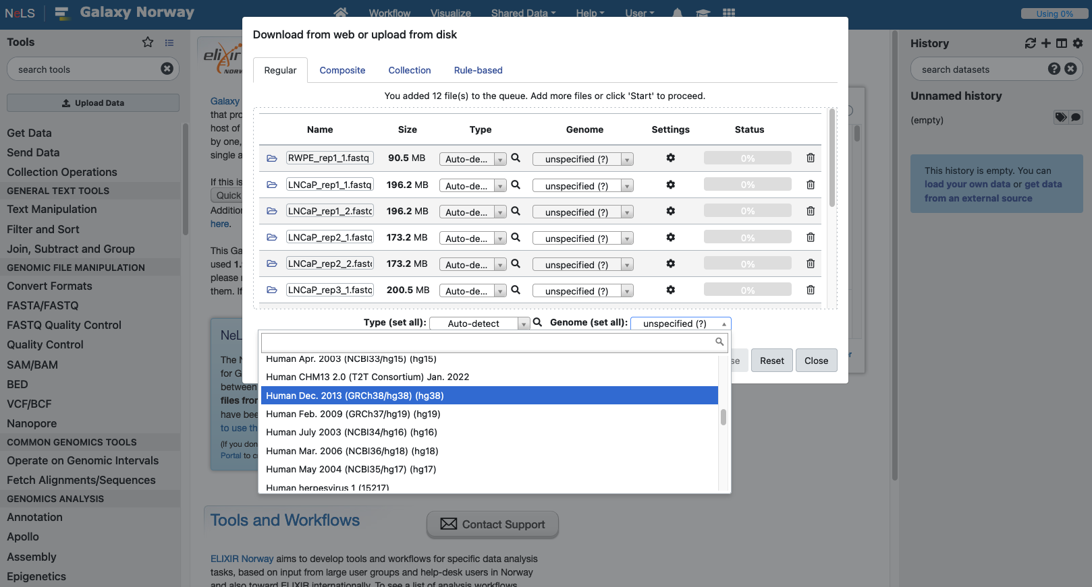
Importing data from NeLS
Specify datatype if you know (e.g. fastqsanger)
If your data is aligned reads or will be aligned to a genome, specify this reference genome

Slide 21
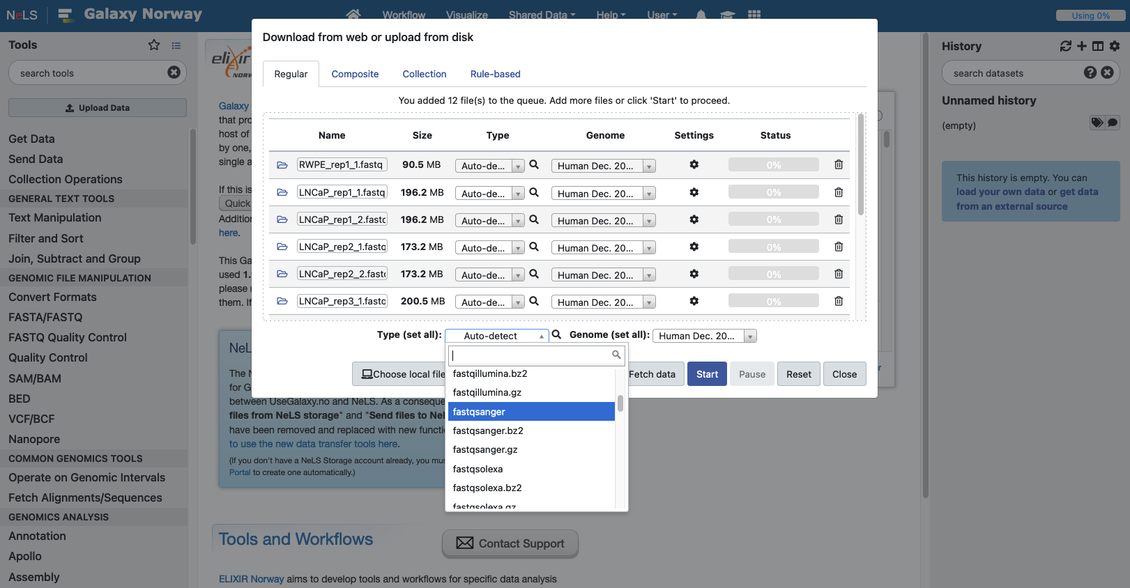
Importing data from NeLS

Slide 22
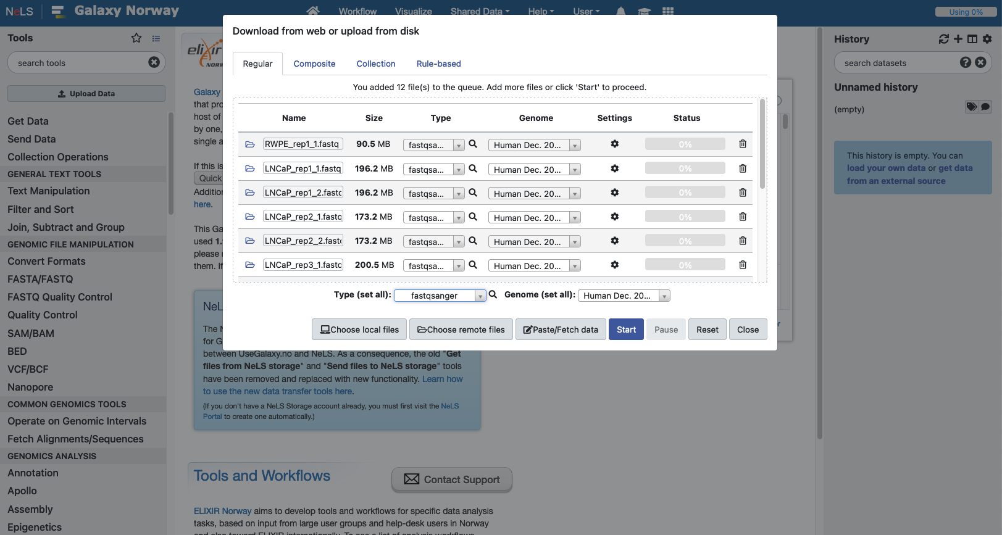
Importing data from NeLS

Slide 23
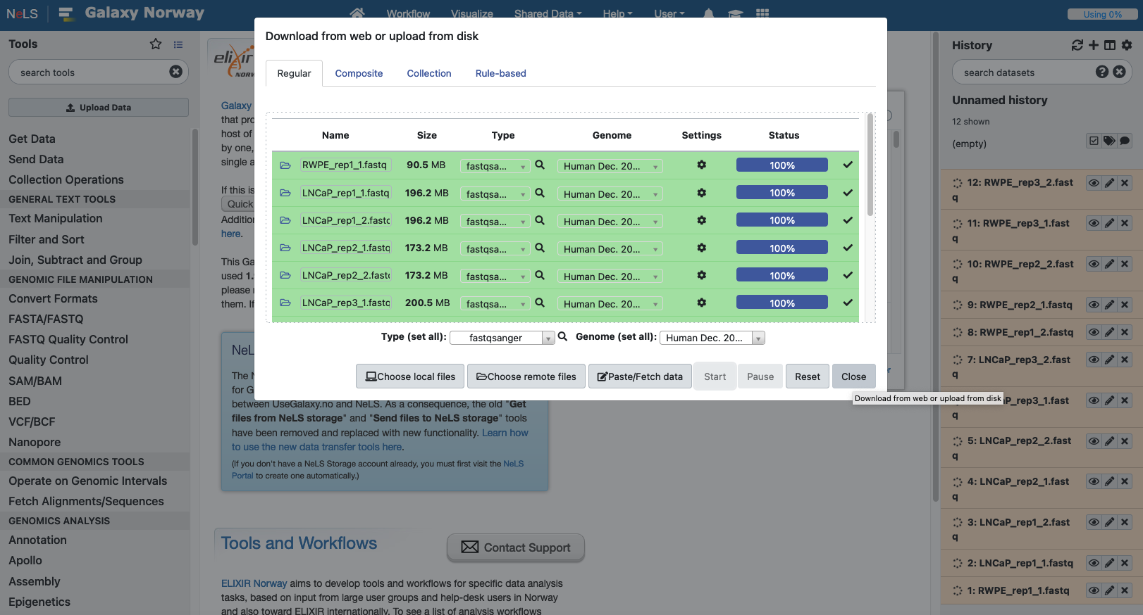
Importing data from NeLS

Slide 24
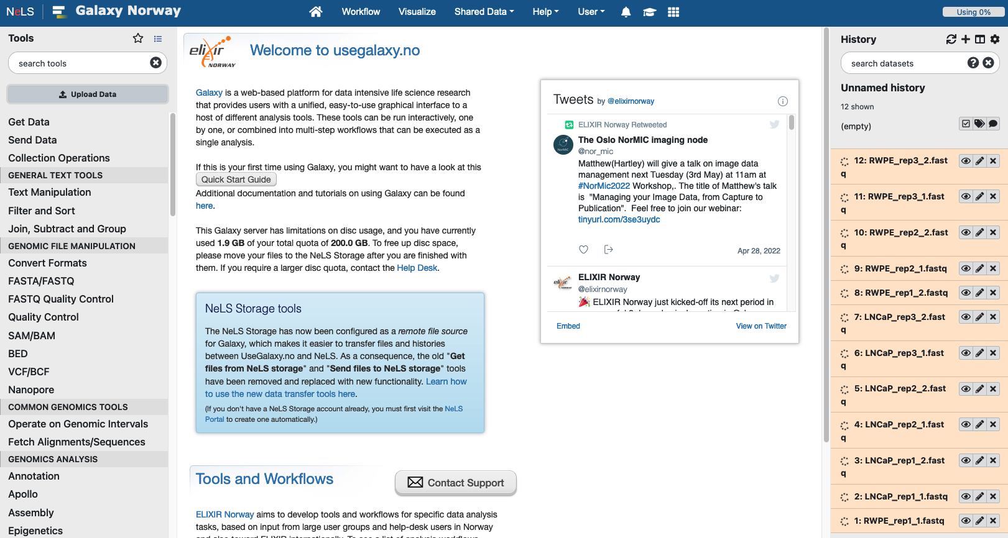
Importing data from NeLS & Histories
New datasets:
either uploaded to Galaxy
or generated by running a tool
New datasets are added to top of the user's current history (with a number)
Histories represent a chronological record of all the steps you have performed in your analysis
Every dataset in a history includes complete information about how that dataset was created, for instance which tool was used to produce the data and the specific parameter settings that tool was run with
Makes it possible to trace the provenance and evolution of each dataset through time, and it also enables automatic extraction of workflows from a history to reproduce the complete analysis or apply the same processing steps to other datasets.

Slide 25
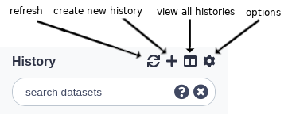
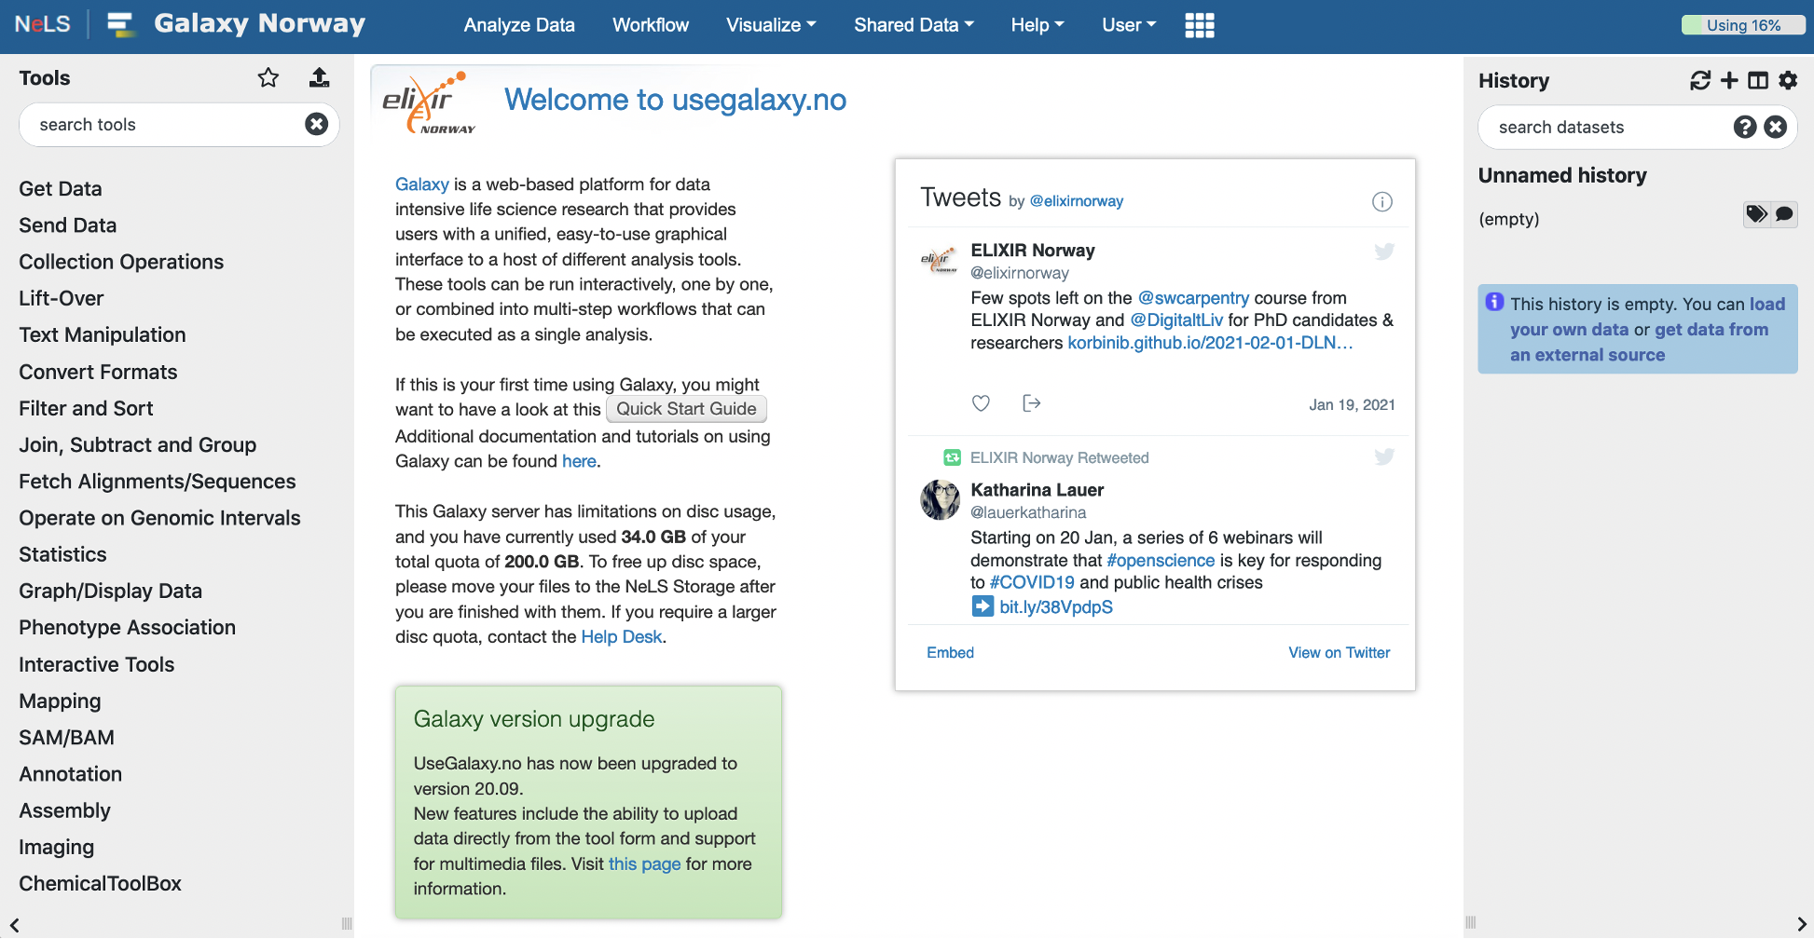
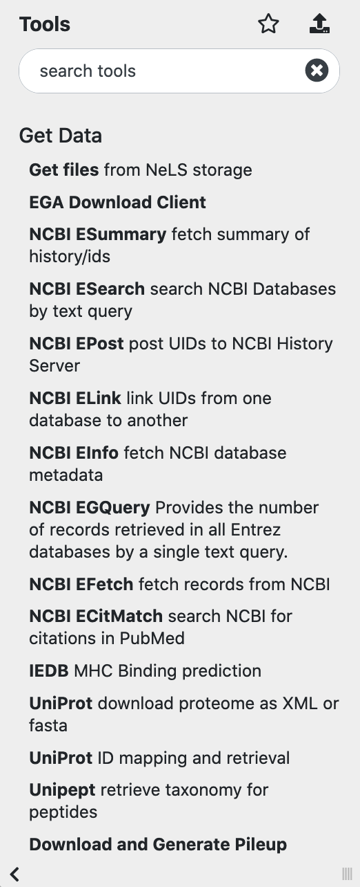
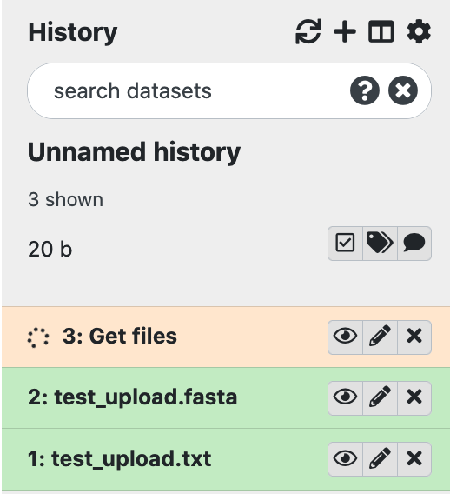
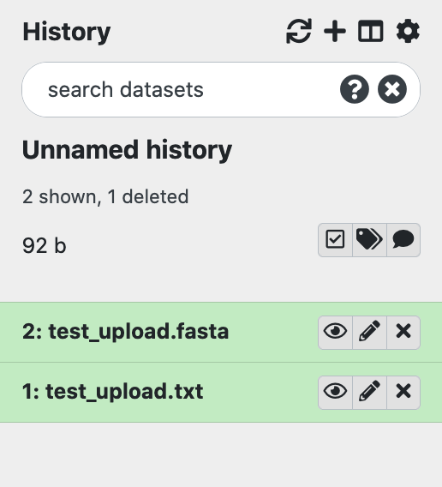
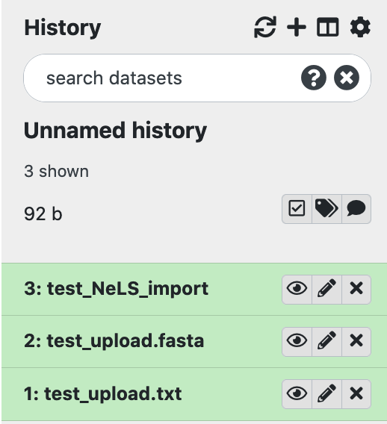
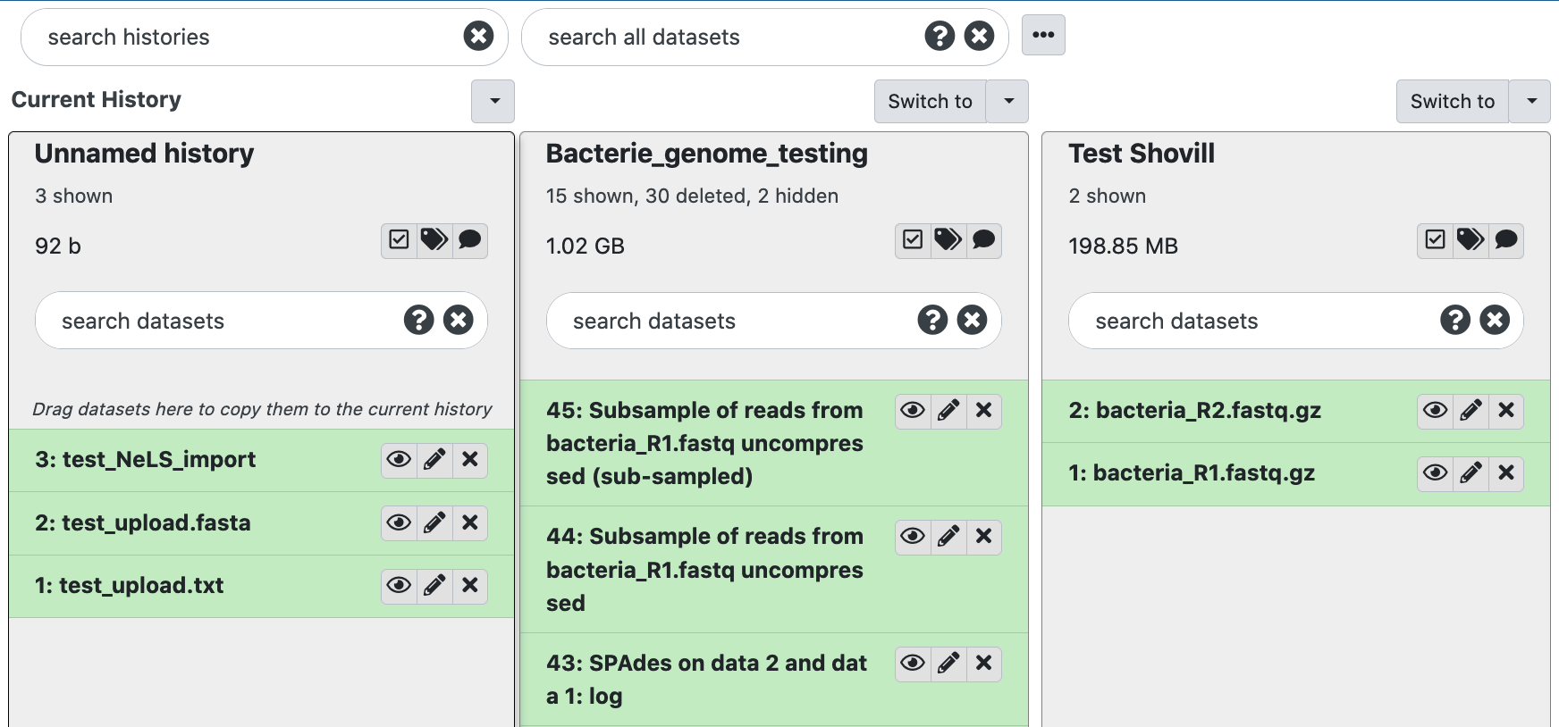
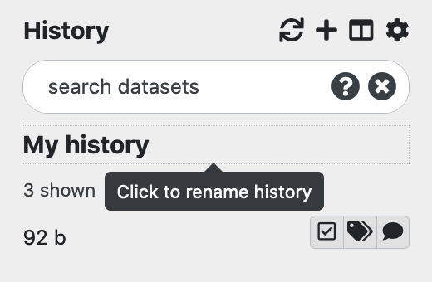
Use galaxy histories to organise data
You can make as many histories as you want and switch between them
Typically, you can have one history for each project or analysis
You can rename your histories, all must have unique names (Press enter to save the name)

Slide 26
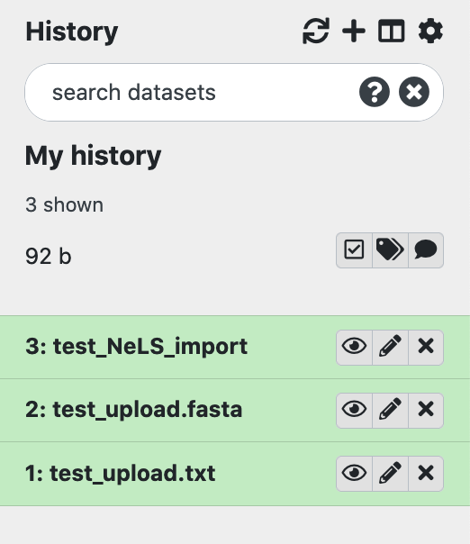
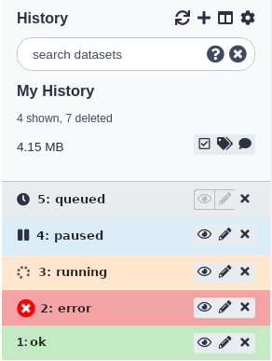
A dataset is equivalent to file(s)
In Galaxy the term dataset are the inputs and outputs of each step in an analysis project
Datasets also can be a collection of files, or a list of files
Datasets can have different states
Job has not yet started but will create this dataset
Paused jobs can be resumed but will create this dataset
Job is running but will create this dataset
The job failed with an error
The job completed successfully

Slide 27
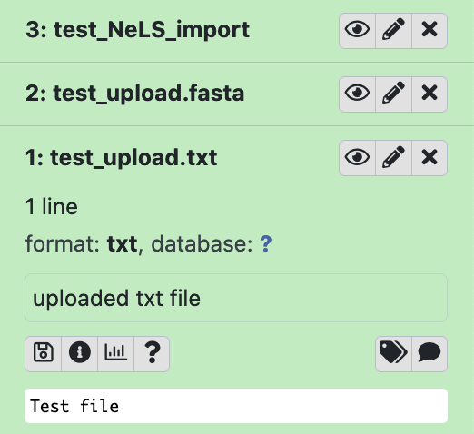
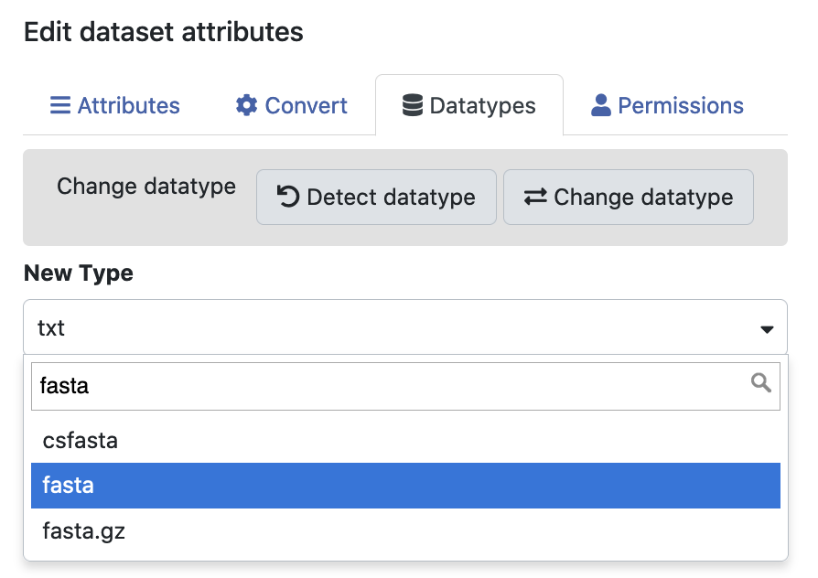
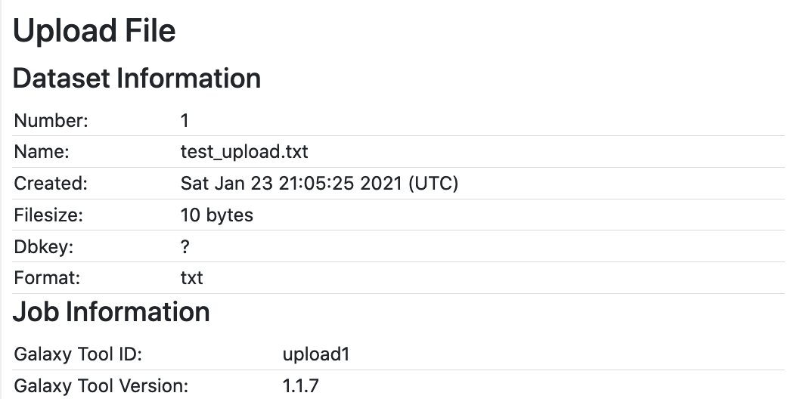
Operations and information on datasets
View data
Edit attributes
Delete data
Multiple operations can be performed on each dataset
View dataset by clicking on the filename
Change format (datatype) of dataset
Extensive information for each dataset in the history
For example, version of the tool and reference genome used in an analysis
Data description
Download data
Detailed information

Slide 28
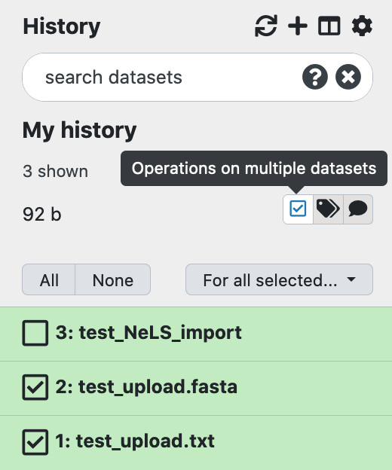
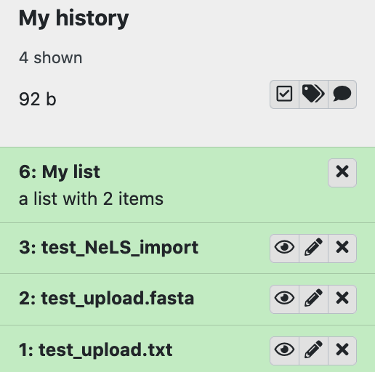
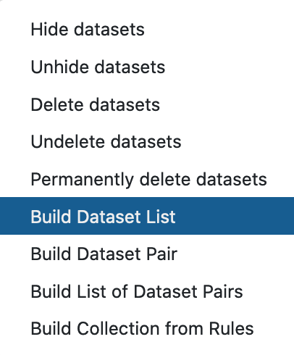
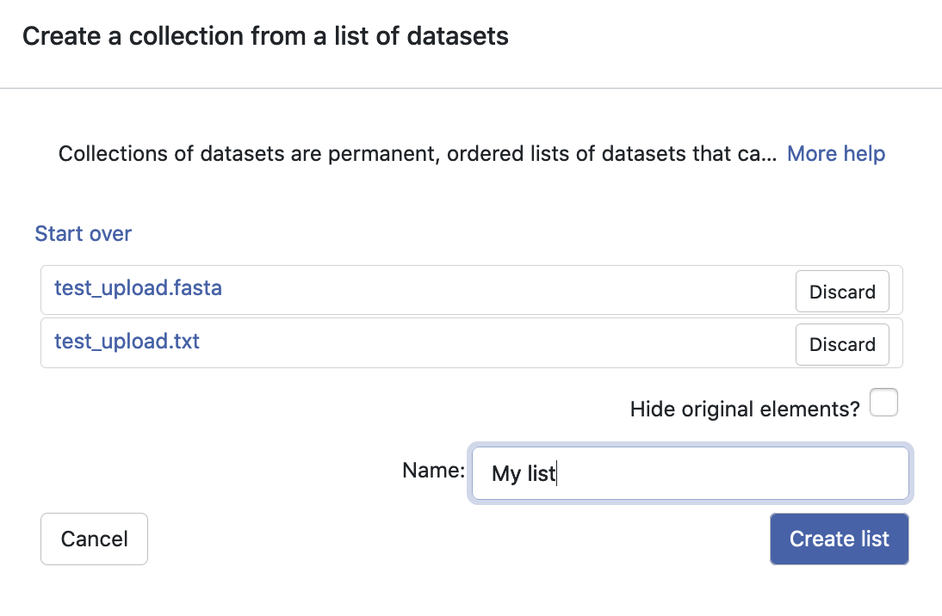
Dataset Collections for operation on multiple files
You can create dataset collections or list of multiple datasets that will be sent through the same analysis
Different types of collections and list are created by selecting dataset from your history
After naming the collection/list, it will appear in your history

Slide 29
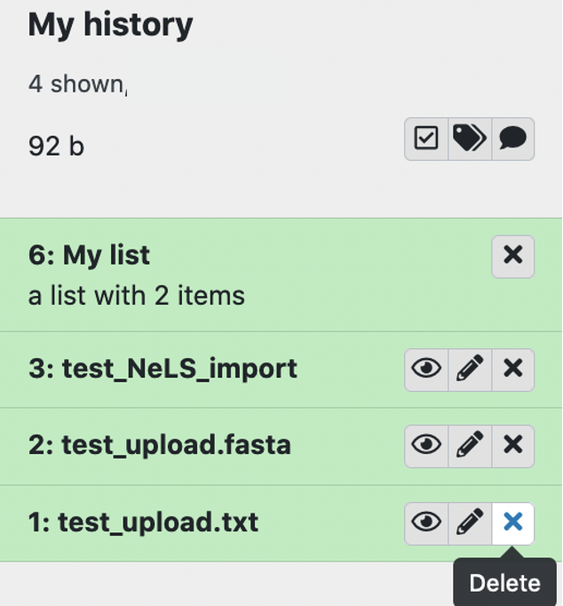
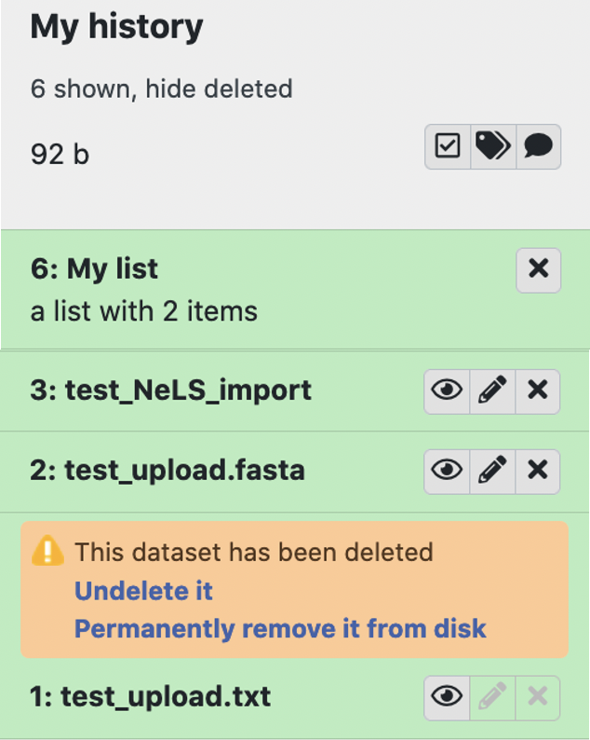
Delete and permanently delete datasets
Deleting a dataset (and histories) is equal to hiding the data, or putting it in the trash bin
It is possible to recover deleted datasets
Permanently deleting (purging) datasets (and histories) will free up disk space and cannot be recovered

Slide 30
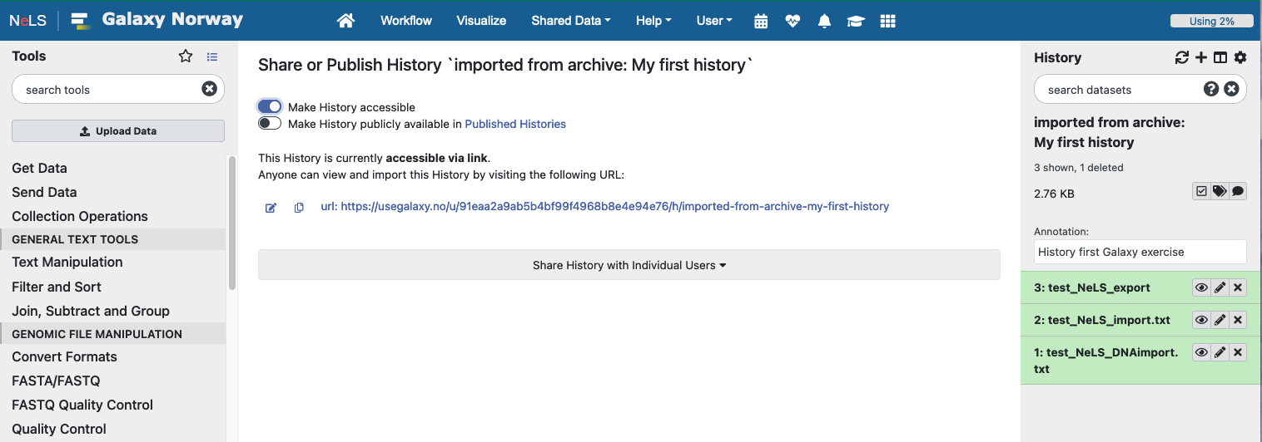
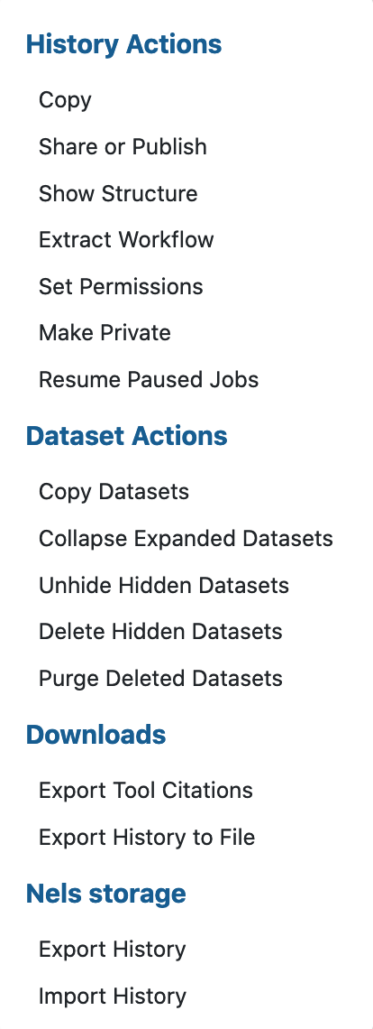
Galaxy sharing data
An efficient method for sharing analysis with collaborators
Good practice to get support from the Helpdesk

Slide 31
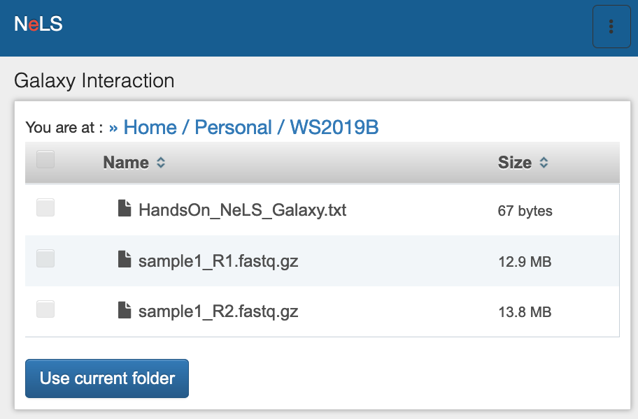

Exporting data
IMPORTANT: usegalaxy.no is not meant for storage
Please move your data when your data analysis is done
You can export a complete history including datasets to a file on your local system or to NeLS

